Slide 1
X = Predictor Variable
Independent Variable
Regressor
E means “mean”
$$E\left(Y | X=x\right)$$
Y = Outcome Variable
Dependent Variable
Regressand
Notes:
regression_equation_annotated_01

Slide 2
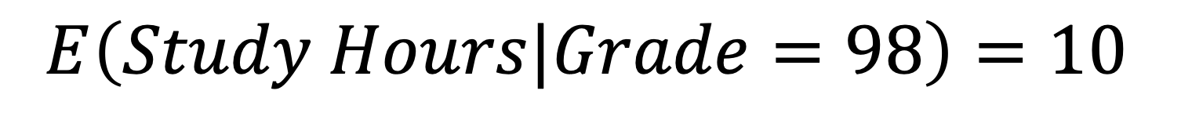
E means “mean”
X = Predictor Variable
Independent Variable
Regressor
$$E\left(Study Hours|Grade=98\right)=10$$
Y = Outcome Variable
Dependent Variable
Regressand
Notes:
regression_equation_annotated_02

Slide 3
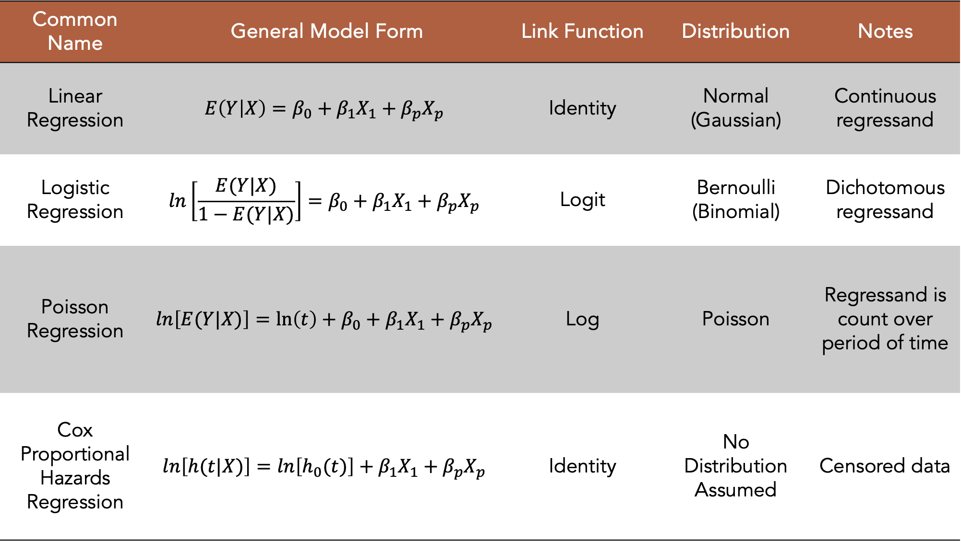
Common Name | General Model Form | Link Function | Distribution | Notes
Linear Regression | $$E\left(Y | X\right)=β_{0}+β_{1}X_{1}+β_{p}X_{p}$$ | Identity | Normal (Gaussian) | Continuous regressand
Logistic Regression | $$ln\left[\frac{E(Y|X)}{1−E(Y|X)}\right]=β_{0}+β_{1}X_{1}+β_{p}X_{p}$$ | Logit | Bernoulli (Binomial) | Dichotomous regressand
Poisson Regression | $$ln\left[E(Y|X)\right]=\ln\left(t\right)+β_{0}+β_{1}X_{1}+β_{p}X_{p}$$ | Log | Poisson | Regressand is count over period of time
Cox Proportional Hazards Regression | $$ln\left[h(t|X)\right]=ln\left[h_{0}(t)\right]+β_{1}X_{1}+β_{p}X_{p}$$ | Identity | No Distribution Assumed | Censored data
Notes:
regression_models_01

Slide 4
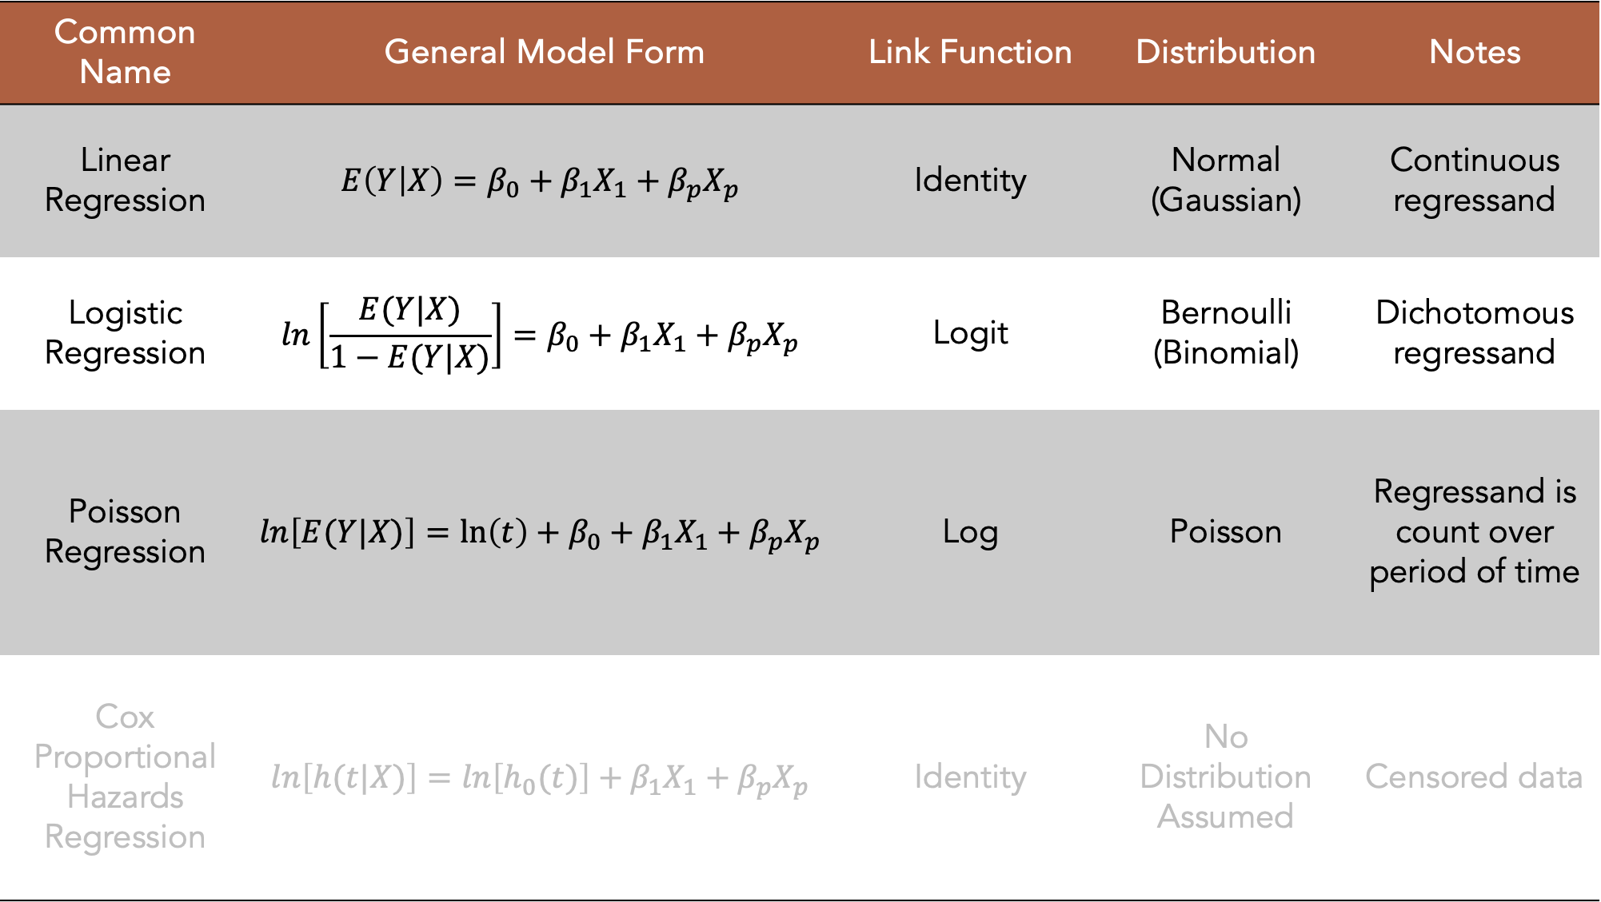
Common Name | General Model Form | Link Function | Distribution | Notes
Linear Regression | $$E\left(Y | X\right)=β_{0}+β_{1}X_{1}+β_{p}X_{p}$$ | Identity | Normal (Gaussian) | Continuous regressand
Logistic Regression | $$ln\left[\frac{E(Y|X)}{1−E(Y|X)}\right]=β_{0}+β_{1}X_{1}+β_{p}X_{p}$$ | Logit | Bernoulli (Binomial) | Dichotomous regressand
Poisson Regression | $$ln\left[E(Y|X)\right]=\ln\left(t\right)+β_{0}+β_{1}X_{1}+β_{p}X_{p}$$ | Log | Poisson | Regressand is count over period of time
Cox Proportional Hazards Regression | $$ln\left[h(t|X)\right]=ln\left[h_{0}(t)\right]+β_{1}X_{1}+β_{p}X_{p}$$ | Identity | No Distribution Assumed | Censored data
Notes:
regression_models_02

Slide 5
Terminology
If E(Y|X=x) is the mean value of Y when X=x, then…
E(Y|X₁=x₁, X₂=x₂…, X_{p}=x_{p}) is the mean value of Y when X₁=x₁, X₂=x_{2,} and so on.
Notes:
terminology_01

Slide 6
Terminology
If E(Y|X=x) is the mean value of Y when X=x, then…
E(Y|X₁=x₁, X₂=x₂…, X_{p}=x_{p}) is the mean value of Y when X₁=x₁, X₂=x_{2,} and so on.
To make notation simpler:
X = Vector of all the dependent variables in a given function, and
Notes:
terminology_02

Slide 7
Terminology
If E(Y|X=x) is the mean value of Y when X=x, then…
E(Y|X₁=x₁, X₂=x₂…, X_{p}=x_{p}) is the mean value of Y when X₁=x₁, X₂=x_{2,} and so on.
To make notation simpler:
X = Vector of all the dependent variables in a given function, and
x = Vector of the values of those dependent variables
Notes:
terminology_03

Slide 8
Terminology
If E(Y|X=x) is the mean value of Y when X=x, then…
E(Y|X₁=x₁, X₂=x₂…, X_{p}=x_{p}) is the mean value of Y when X₁=x₁, X₂=x_{2,} and so on.
To make notation simpler:
X = Vector of all the dependent variables in a given function, and
x = Vector of the values of those dependent variables
For example, X could represent (Age, Race, and CVD)
x could then take on values of age, race categories, and (Yes/No) for CVD.
Notes:
terminology_04

Slide 9

Slope-intercept form of a line
$$y=mx+b$$
Slope
Intercept
Notes:
slope_intercept_01

Slide 10

$$y=2x+3$$
X | Y
6
5
4
3
2
1
0
Notes:
slope_intercept_02

Slide 11
$$y=2x+3$$
X | Y
6 | 15
5 | 13
4 | 11
3 | 9
2 | 7
1 | 5
0 | 3
Notes:
slope_intercept_03

Slide 12
$$y=2x+3$$
X | Y
6 | 15
5 | 13
4 | 11
3 | 9
2 | 7
1 | 5
0 | 3
Notes:
slope_intercept_04

Slide 13

Linear model
$$E\left(Y | X\right)=β_{0}+β_{1}X_{1}$$
Intercept
Slope
Notes:
slope_intercept_05

Slide 14
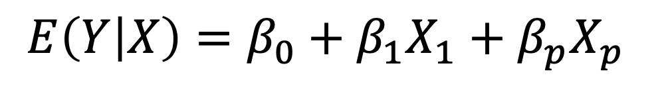
Linear model
$$E\left(Y | X\right)=β_{0}+β_{1}X_{1}+β_{p}X_{p}$$
Intercept
Slope
Notes:
slope_intercept_06

Slide 15
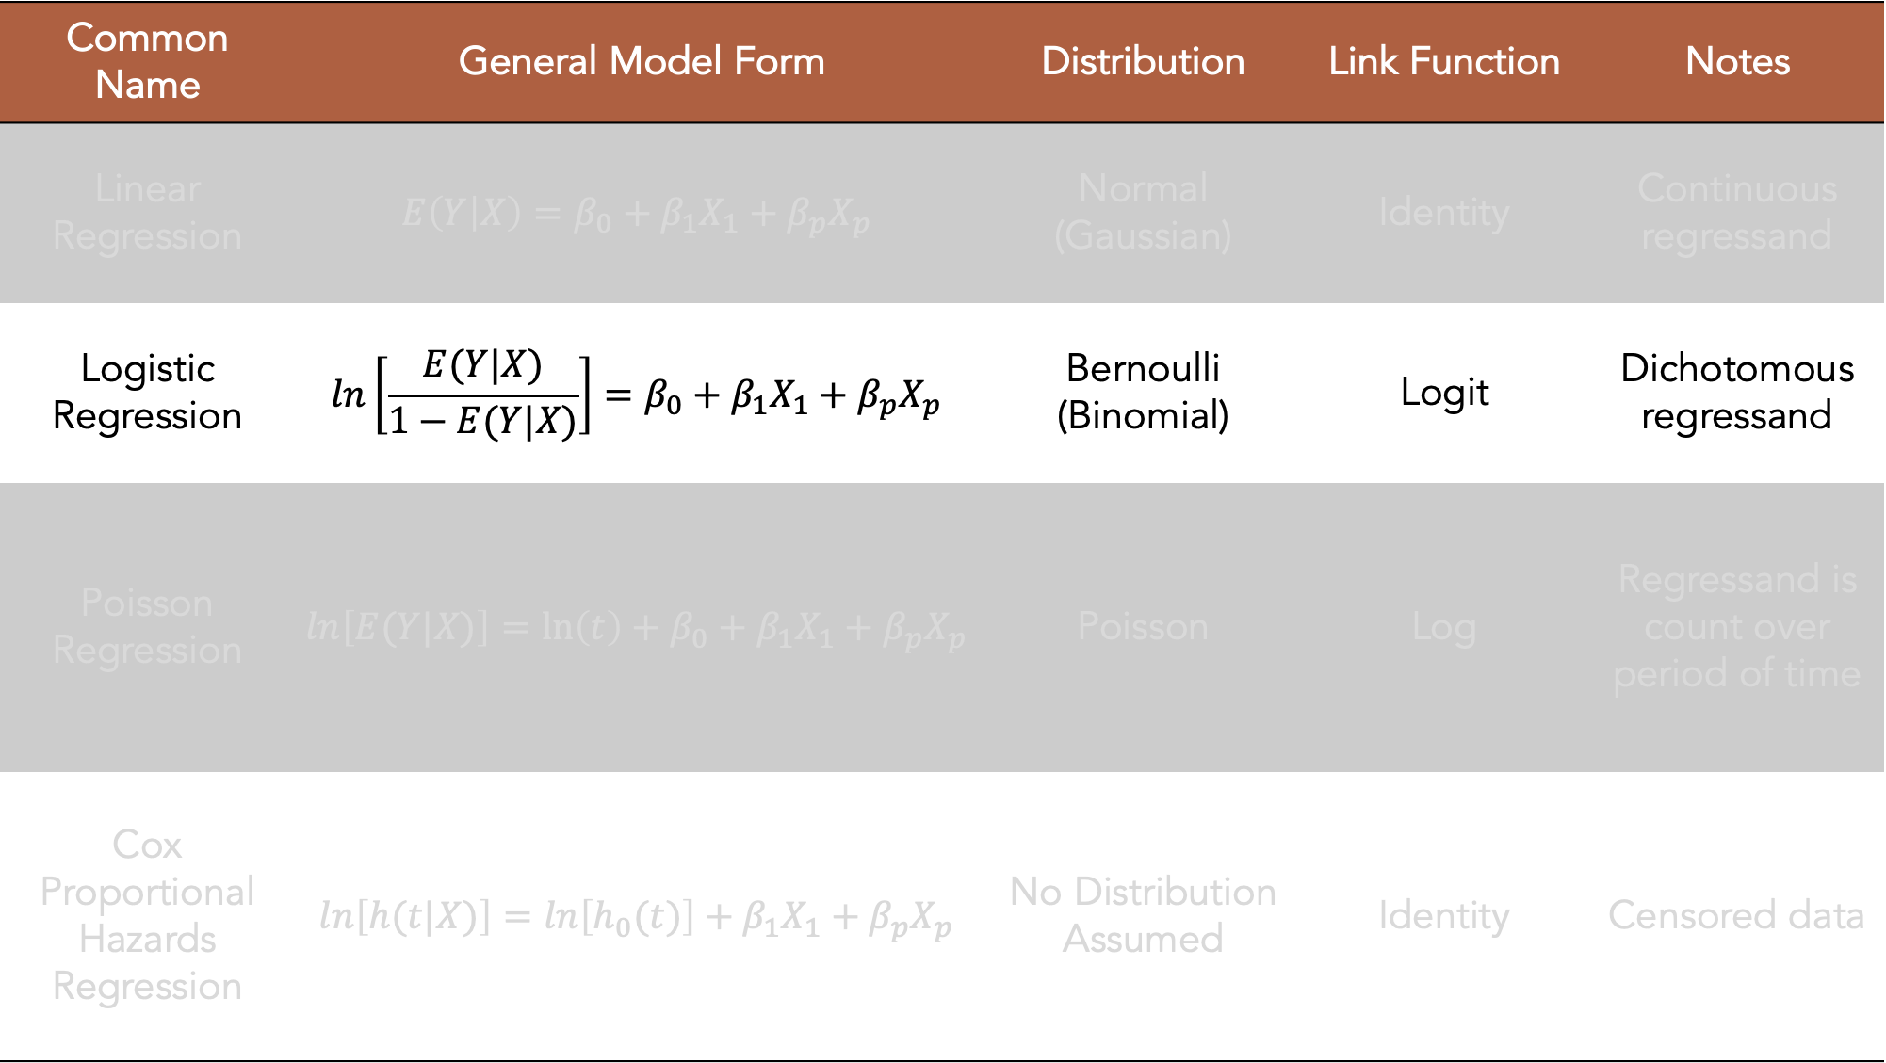
Common Name | General Model Form | Distribution | Link Function | Notes
Linear Regression | $$E\left(Y | X\right)=β_{0}+β_{1}X_{1}+β_{p}X_{p}$$ | Normal (Gaussian) | Identity | Continuous regressand
Logistic Regression | $$ln\left[\frac{E(Y|X)}{1−E(Y|X)}\right]=β_{0}+β_{1}X_{1}+β_{p}X_{p}$$ | Bernoulli (Binomial) | Logit | Dichotomous regressand
Poisson Regression | $$ln\left[E(Y|X)\right]=\ln\left(t\right)+β_{0}+β_{1}X_{1}+β_{p}X_{p}$$ | Poisson | Log | Regressand is count over period of time
Cox Proportional Hazards Regression | $$ln\left[h(t|X)\right]=ln\left[h_{0}(t)\right]+β_{1}X_{1}+β_{p}X_{p}$$ | No Distribution Assumed | Identity | Censored data
Intercept
Slope
Notes:
regression_models_03

Slide 16
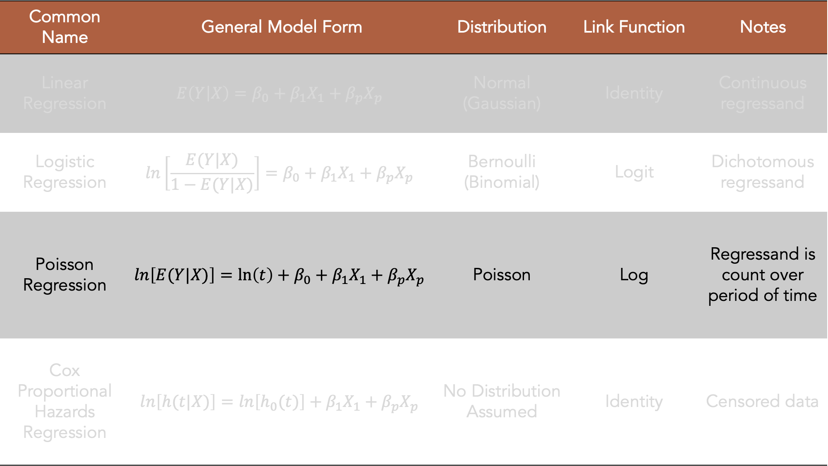
Common Name | General Model Form | Distribution | Link Function | Notes
Linear Regression | $$E\left(Y | X\right)=β_{0}+β_{1}X_{1}+β_{p}X_{p}$$ | Normal (Gaussian) | Identity | Continuous regressand
Logistic Regression | $$ln\left[\frac{E(Y|X)}{1−E(Y|X)}\right]=β_{0}+β_{1}X_{1}+β_{p}X_{p}$$ | Bernoulli (Binomial) | Logit | Dichotomous regressand
Poisson Regression | $$ln\left[E(Y|X)\right]=\ln\left(t\right)+β_{0}+β_{1}X_{1}+β_{p}X_{p}$$ | Poisson | Log | Regressand is count over period of time
Cox Proportional Hazards Regression | $$ln\left[h(t|X)\right]=ln\left[h_{0}(t)\right]+β_{1}X_{1}+β_{p}X_{p}$$ | No Distribution Assumed | Identity | Censored data
Intercept
Slope
Offset
Notes:
regression_models_04

